Slide 1



AUTISM SPECTRUM DISORDER DETECTION USING A DENSENET–EFFICIENTNET ENSEMBLE DEEP LEARNING MODEL
Team Members:
Dhanya S - 23MIA1010
Shweta V - 23MIA1050
Samyuktha S - 23MIA1162

Slide 2
MOTIVATION / PROBLEM STATEMENT
  Early Autism Spectrum Disorder (ASD) diagnosis is challenging, subjective, and time-consuming.
  Subtle facial features linked to ASD can be detected using deep learning.
  Existing single CNN models show limited generalization on small, diverse datasets.
  Need for a robust ensemble model that combines multiple architectures to improve accuracy and reliability.
  Proposed DenseNet–EfficientNet ensemble aims to deliver non-invasive, automated, and scalable ASD screening through facial images.

Slide 3
BASE PAPER SUMMARY
Title: A Deep Learning-Based Ensemble for Autism Spectrum Disorder Diagnosis Using Facial Images
Authors: Tayyaba Farhat et al., 2025
Goal: Detect ASD from facial images using deep learning.
Dataset: Autism Image Data (balanced autistic & non-autistic).
Method: Ensemble of VGG16 and Xception with transfer learning and feature fusion.
Preprocessing: Face alignment, noise reduction, histogram equalization, data augmentation.
Result: Achieved 97% accuracy, outperforming single models.
Conclusion: Ensemble fusion enhances accuracy and reliability in ASD detection.

Slide 4
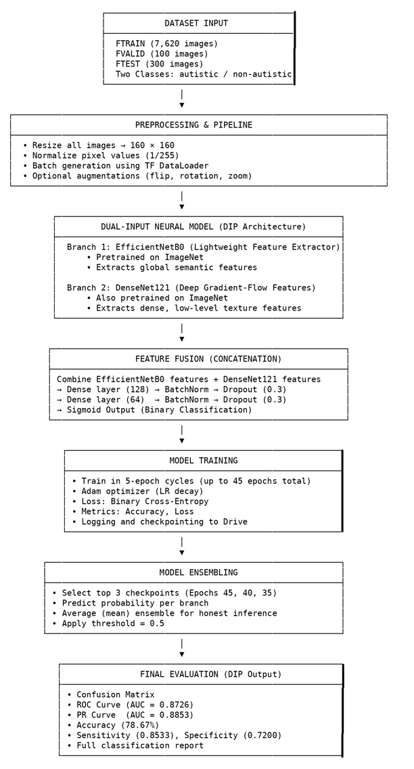
METHODOLOGY

Slide 5
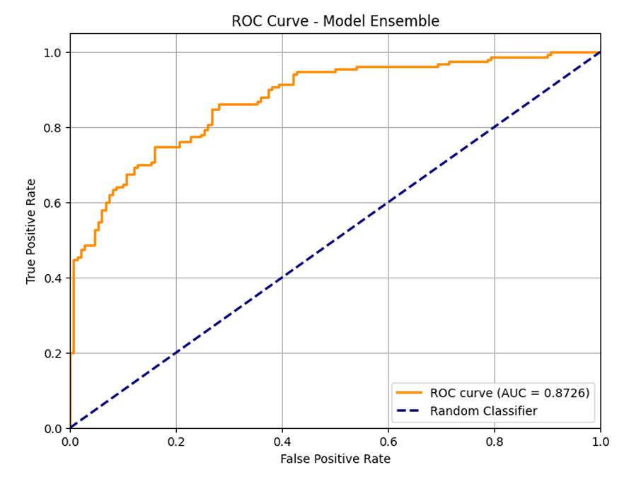
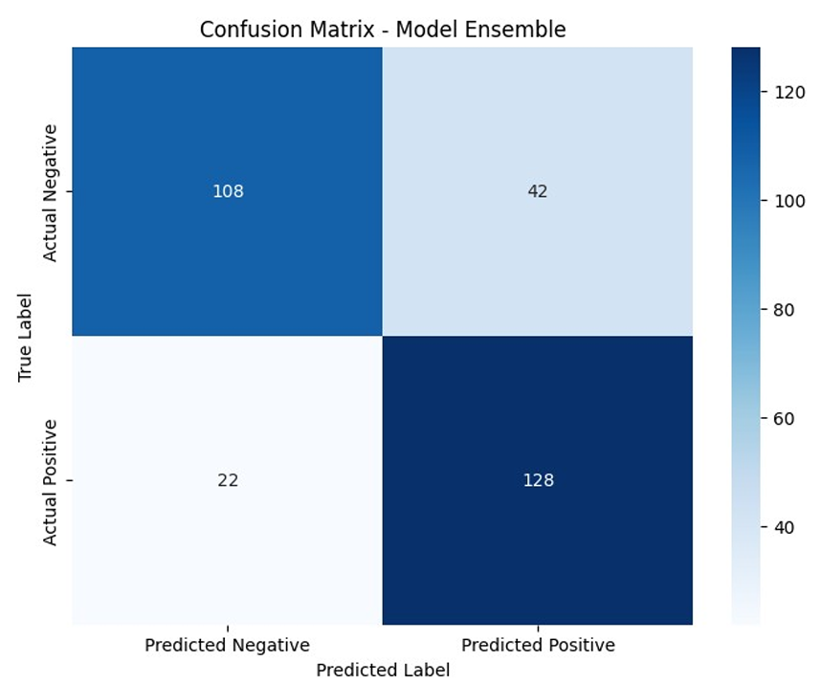
RESULTS

Slide 6
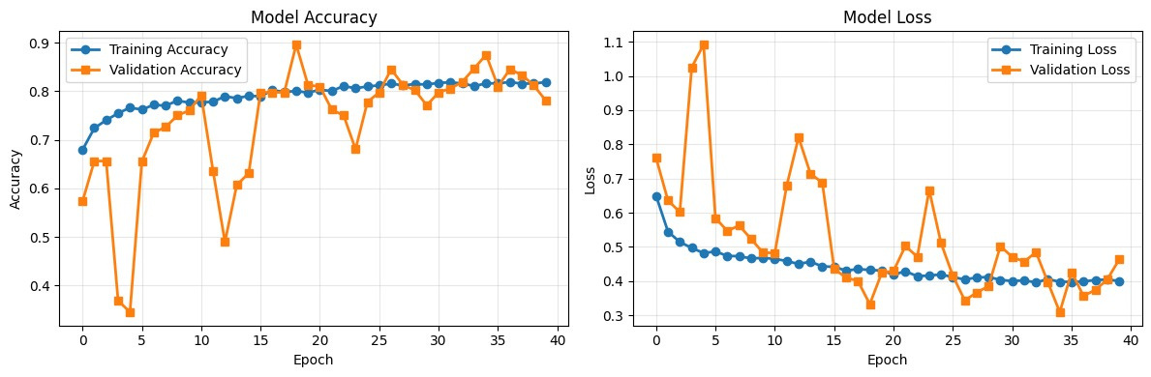
RESULTS

Slide 7
KEY FINDINGS
Model Performance
Best Validation Accuracy: 89.58% at Epoch 19
Best Training Accuracy: 82.50% at Epoch 42
Validation accuracy consistently remained higher than training, indicating good generalization.
Ensemble Evaluation Metrics
Overall Accuracy: 78.67%
Sensitivity (Recall for Autistic class): 0.8533
Specificity (Recall for Non-Autistic class): 0.7200
ROC AUC: 0.8726
PR AUC: 0.8853
Classification Insights
The Dual-Input Pipeline (DIP) effectively combines EfficientNetB0 and DenseNet121 for robust feature extraction.
Ensemble averaging (Epochs 45, 40, 35) improved stability and confidence of predictions.
The model shows strong discrimination capability between autistic and non-autistic facial features.
Behavior Observed During Training
Early epochs showed rapid learning → plateau at middle stages.
Slight signs of overfitting after Epoch 30, but ensemble inference mitigated this.

Slide 8
FUTURE ENHANCEMENTS
Model Improvements
Fine-tune pretrained layers of EfficientNetB0 and DenseNet121 instead of using fully frozen feature extractors.
Add attention modules (e.g., SE-blocks or CBAM) to strengthen discriminative feature learning.
Introduce Grad-CAM / Grad-CAM++ for model explainability and transparent decision making.
Training Enhancements
Implement Early Stopping based on validation accuracy or loss to prevent late-epoch overfitting.
Add learning rate scheduling (Cosine decay, ReduceLROnPlateau).
Use data balancing or class-specific augmentation to improve specificity.
Dataset-Level Improvements
Increase dataset diversity (age, pose, ethnicity) for better generalization.
Add more samples for the non-autistic class to reduce bias in sensitivity/specificity.
Ensembling & Deployment
Experiment with weighted ensembling instead of mean averaging.
Try stacked ensemble with meta-learners (XGBoost / Logistic Regression).
Convert model to TensorRT / TFLite for edge deployment in diagnostic tools.
Research Extensions
Integrate multi-modal signals (eye-tracking, behavioral markers).
Compare DIP with Vision Transformers (ViT / Swin) for state-of-the-art performance.

